Slide 1
Hermeticism & gnosticism Dr. Stephanie Spoto sspoto@mpc.edu Monterey Peninsula College
Gentrain
13 February 2019

Slide 2
Hermetic Belief
Hermeticism came out of Hellenistic Greek, and influential in the development of early Christianity → had a resurgence during the Renaissance and Reformation.
A combination of different philosophies and beliefs from south eastern Europe, west Asia and Northern Africa.
Focus today:
Sources
Hermetic beliefs
Religious syncretism and historical context
Comparison with Gnostic Christianity

Slide 3
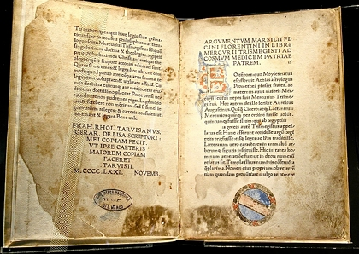
Sources: The Corpus Hermeticum
Collection of Egyptian-Greek wisdom texts
Earliest texts from 2nd century CE
Discuss alchemy, divine cosmos, astrology, nature, and mind
Corpus Hermeticum: first Latin edition, by Marsilio Ficino, 1471 AD, an edition which belonged formerly to the Bibliotheca Philosophica Hermetica, Amsterdam.

Slide 4
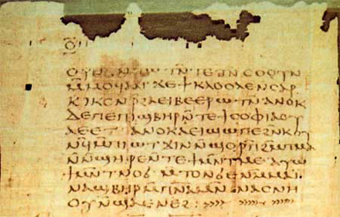
Sources: The Nag Hammadi
Owned by Egypt, the codices are kept in the Coptic Museum in Cairo. Here, the beginning of the apocalypse of St. Peter.
Discovered in Egypt in 1945 → originated 1st or 2nd century CE
Their discovery shed light on the development of early Gnostic Christianity
Some of the texts are clearly Gnostic, but others diverge.

Slide 5
Hermetic Beliefs The World’s Origin
First chapter of Corpus, “Poimandres”: Defining the order of the soul through the origin story of humans and the soul. Conversation between Poimandres and an unnamed man.
Nous: the bridge between The All and its contents → also can be “thought”
Chaotic and Watery darkness penetrated by fire: “You saw in Nous the first form, which is prior to the beginning of the beginningless and endless.”
The original Nous created the Word, another Nous. The Word created the world of the elements, creatures (without intelligence/nous/speech).
Then created Man → also given the power to create. As he descended to Earth, we united with Nature → became trapped in the world through falling in love with Nature.

Slide 6
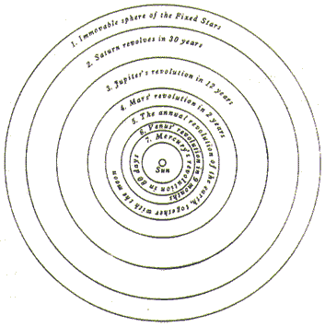
9 celestial spheres, with humans on the lowest sphere. Highest two are the domain of God.
The human descent through the planetary spheres caused man’s dependence on their influence - astrology

Slide 7
The Split Nature of Man
This conception of the cosmos leads to dualism: the split nature of man. → human bodies and their connection/interaction with the material world is antagonistic to the needs of the soul
Created in the heavens and then descending to Earth → humans have a unique place in the cosmos, different from the other animals.
Because the original Man had gone to earth and united with nature he became different from all the other creatures of earth.
“For this reason, of all living being on earth, Man alone is double: mortal because of the body, immortal because of the real Man, For although being immortal and having authority over all, he suffers mortal things which are subject to destiny. Then, although above the harmony of the Cosmos, he has become a slave within it.”
(Corpus Hermeticum, Book I)

Slide 8
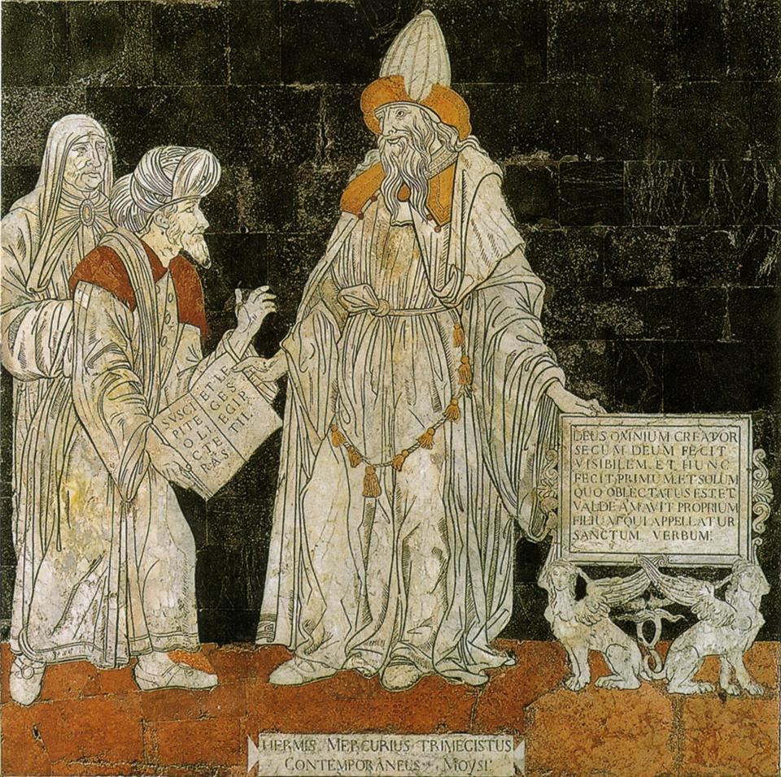
Salvation through Gnosis
Though this duality is a problem, there is a solution in salvation through gnosis → must learn/remember true nature (c.f. Neoplatonism)
“This kind of knowledge is not taught, O son, but through God it is remembered, whenever he wills.”
Hermes Mercurius Trismegistus depicted on the floor of Siena’s Duomo (Tuscany). This work is attributed to Giovanni di Stefano and dates to 1488.

Slide 9
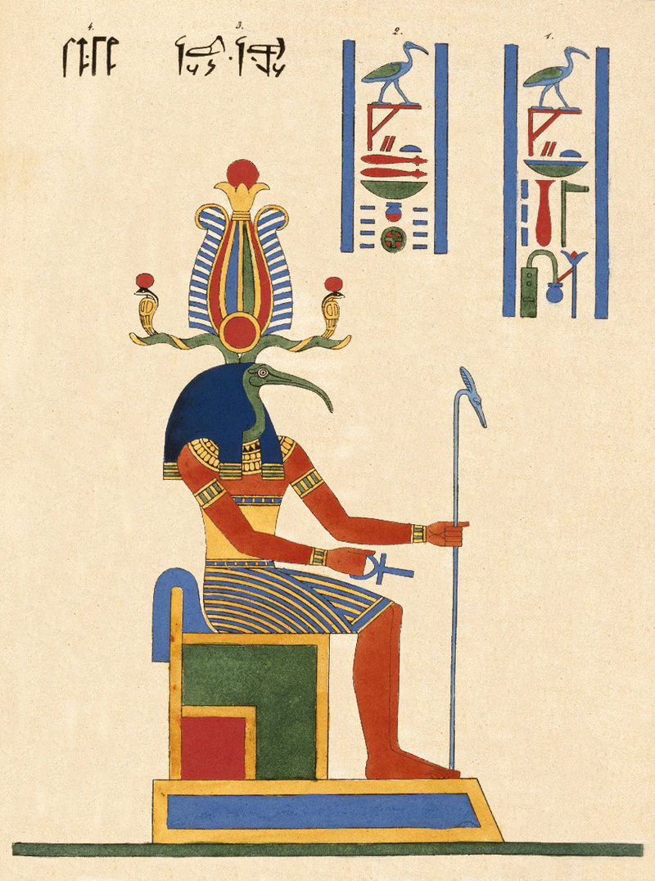
Transcending from the Sensory World
Must disconnect from the world of the senses
“Make idle the senses of the body and the spirit will be reborn.”
Thoout, Thoth Deux fois Grand, le Second Hermés, N372.2A, Brooklyn Museum

Slide 10
The Hermetic Tradition & Religious Syncretism
Hermes Trismegistus:
Greek Hermes (messenger God) → shuttled souls between heaven, hell, and earth, mixing between the men and the gods.
Egyptian Ibis headed god Thoth → invented writing and mathematics, and also brought human souls to the land of the dead
“In the interpretatio graeca, foreign deities, including those of Egypt, were understood as equivalents of greek gods and goddesses; they were different in form, but identical in essence…In the fifth century, Herodotus wrote that Hermes and Thoth corresponded to each other, for both were considered to be tricksters, and sometimes even thieves, who, equipped with magical capabilities, were messengers of the gods and conductors of the dead.”
(Ebeling, The Secret History of Hermes Trismegistus).

Slide 11
Hermeticism and Gnosticism similarities
Gnosticism: a prominent heretical movement of the 2nd-century Christian Church, partly of pre-Christian origin. Gnostic doctrine taught that the world was created and ruled by a lesser divinity, the demiurge, and that Christ was an emissary of the remote supreme divine being, esoteric knowledge (gnosis) of whom enabled the redemption of the human spirit.
Often related/compared to hermeticism. When large collection of gnostic texts were discovered (The Nag Hammadi Library), there were several hermetic texts within them.
Similarities:
Both identified as seekers of inner truth forgotten by external/material world
Similar to Hermeticism, gnosis was achieved when person remembered their origin and place in the cosmos
Both relied on “negative theology”

Slide 12
Hermeticism and Gnosticism differences
Hermeticism
Gnosticism
Knowledge of God: God is eventually knowable, in some small way, via nous within humans.
Nature of world: cosmos may contain bad things, but is not inherently bad.
Mythology: On myth → story of Poimandres and the creation of the world
Sex/purity: chastity not a virtue, humans must multiply (procreation does not necessarily need a partner after spiritual rebirth).
Knowledge of God: God is utterly unknowable to humans.
Nature of world: world inherently bad, created out of evil creator.
Mythology: many myths telling different stories → vehicles for truth
Sex/purity: Christ relieves us of the need to procreate → procreation traps another soul, alienated from its true nature

